Slide 1
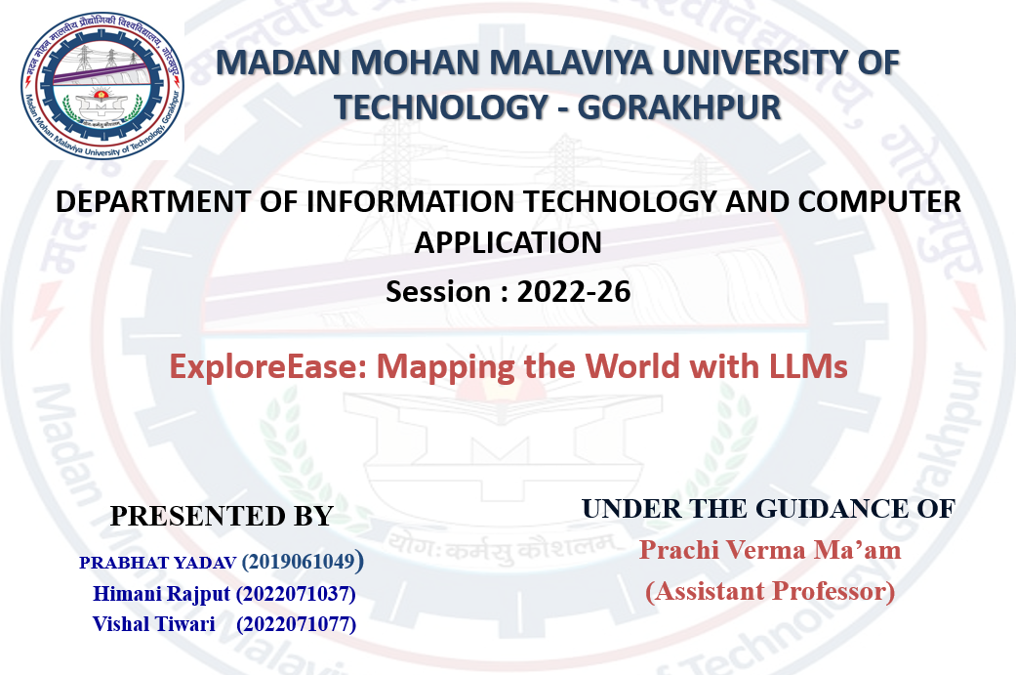

Slide 2

Table of Content
Madan Mohan Malaviya University of Technology, Gorakhpur
S. No. | Description
1. | Introduction & Packing Pain-Points
2. | Objective
3. | Solution Overview
4. | Implementation Architecture Key Modules
5. | Challenges & Mitigations
6. | Future Directions
7. | Q&A

Slide 3

Introduction
Madan Mohan Malaviya University of Technology, Gorakhpur
Job Searching Is Time-Consuming
Fragmented job platforms : Manual search & filtering. Repetitive form filling. Missed opportunities due to limited time.
Impact on Job Search Experience
Excessive time spent exploring multiple platforms. Manual application process increases effort. Repeated data entry leads to frustration. High chances of missing suitable opportunities.

Slide 4
Problem Statement
Madan Mohan Malaviya University of Technology, Gorakhpur
Job opportunities are scattered across multiple platforms, making the search process time-consuming and inefficient.
Lack of personalization leads to irrelevant job recommendations that do not match user skills and preferences.
The application process is repetitive, requiring users to fill the same details multiple times.
Repetitive manual form filling makes the application process slow and tiring.
No centralized system to track and manage job applications effectively.

Slide 5
Objective
Madan Mohan Malaviya University of Technology, Gorakhpur
To develop a system that collects job listings from multiple platforms into a single unified interface.
To build a resume parsing module that extracts key information such as skills, education, and experience.
To implement a semantic matching system that recommends relevant jobs based on user profile and skills.
To develop a browser extension that identifies form fields and automatically fills them using user profile data, reducing manual effort and errors.
To reduce manual effort by enabling automated or one-click job application features.

Slide 6
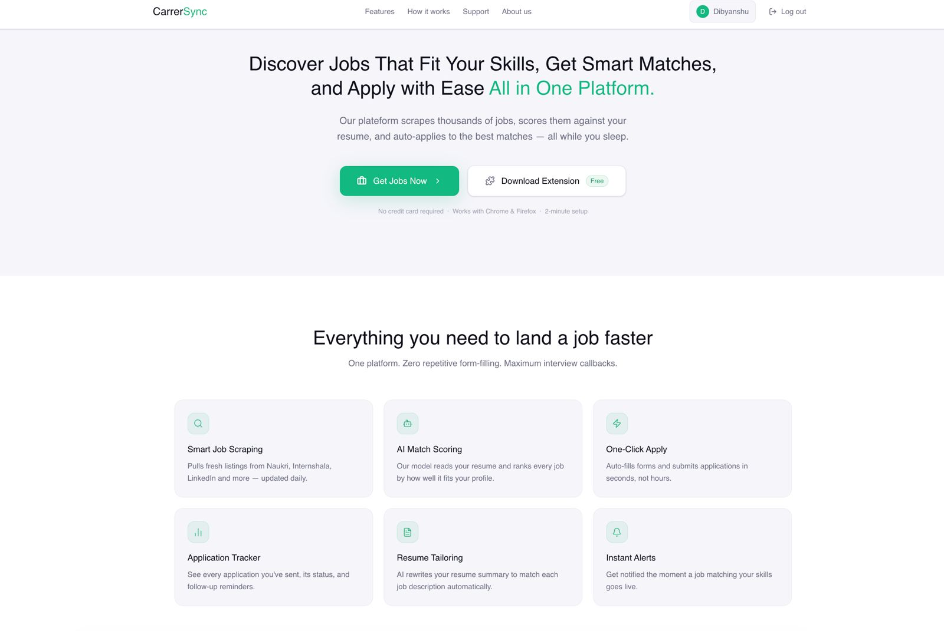
Solution Overview
Madan Mohan Malaviya University of Technology, Gorakhpur
AI Job Platform – One-stop solution for job search and applications.
AI-Based Recommendations – Suggest jobs based on skills & resume.
Resume Parsing System – Extract and store user details.
AutoApply Engine – Apply jobs instantly with user consent.
Browser Extension Support – Enable autofill on company sites.
Application Tracking – Monitor application status, organize job applications, and manage updates efficiently.

Slide 7
Workflow
Madan Mohan Malaviya University of Technology, Gorakhpur
The user logs into the system and uploads their resume to get started
The uploaded resume is parsed using advanced NLP techniques, extracting key information such as skills, education, and experience, and stored in the user profile.
Jobs are displayed to the user based on semantic matching with their skills, experience, and preferences, providing personalized recommendations
The user can apply manually or use the auto-apply feature, which fills applications automatically and tracks their status.
A Chrome extension further enhances automation by directly filling out application forms on job portals for faster submissions.

Slide 8
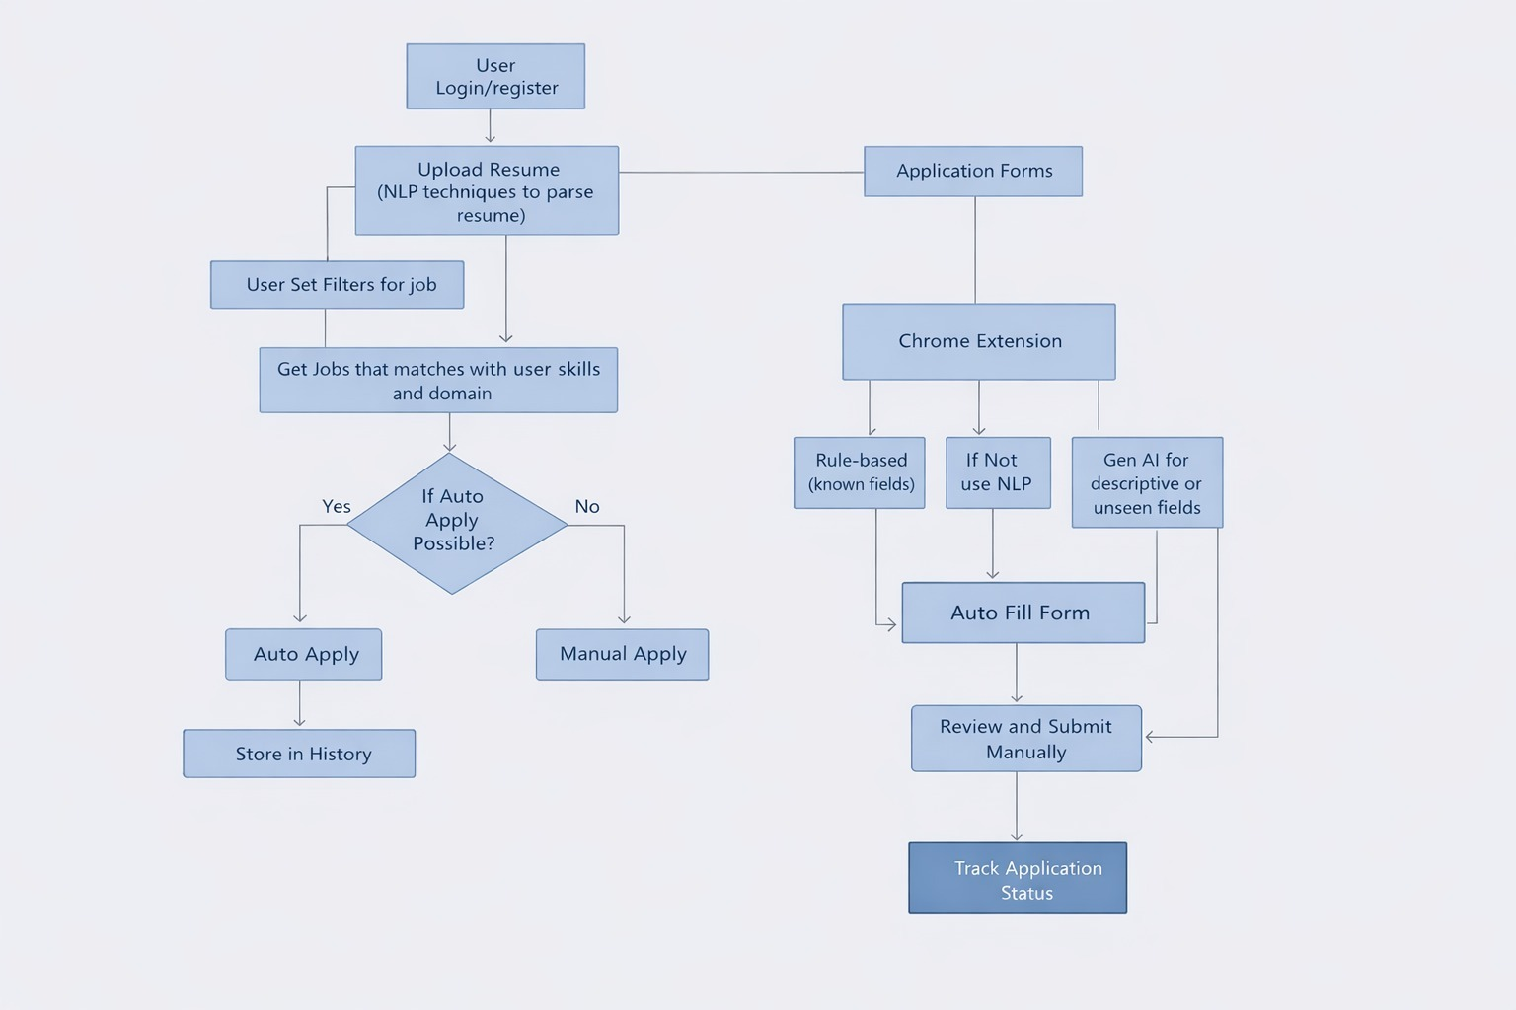
Implementation-FlowChart
Madan Mohan Malaviya University of Technology, Gorakhpur

Slide 9




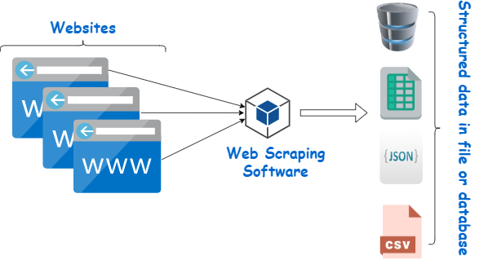

Madan Mohan Malaviya University of Technology, Gorakhpur
Implementation – Technical Architecture
Frontend: React.js , Tailwind CSS , Framer Motion , ShadCN UI .
Backend: Python, FastAPI , MongoDB/Firebase/Postgre, SQL alchemy .
AI/ML: Scikit-learn, Sentence Transformers, pdfplumber, NLTK/SpaCy.
Web Scraping: Selenium, BeautifulSoup , Requests, Playwright

Slide 10
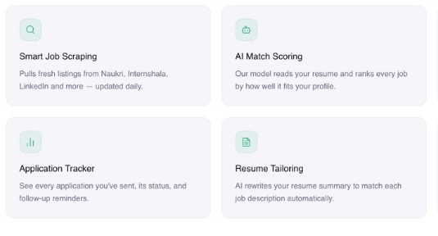
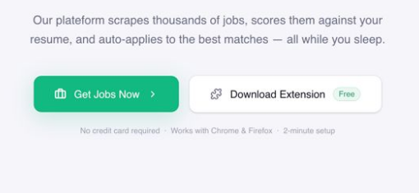
Madan mohan Malaviya University of Technology, Gorakhpur
Implementation – Key Modules
1. Centralized Job Platform
Jobs from multiple portals in one place.
2. Job Recommendations
AI-based job recommendations using resume data and user preferences.
3. Application Tracking
Track and manage job application status efficiently.
4. Automated Application Process
Jobs are auto apply instantly with user consent.
5. Browser Extension Support
Enables autofill where job applications are filled on company sites.
6. Resume Parsing
Extracts details from resume and stores them for autofill.

Slide 11
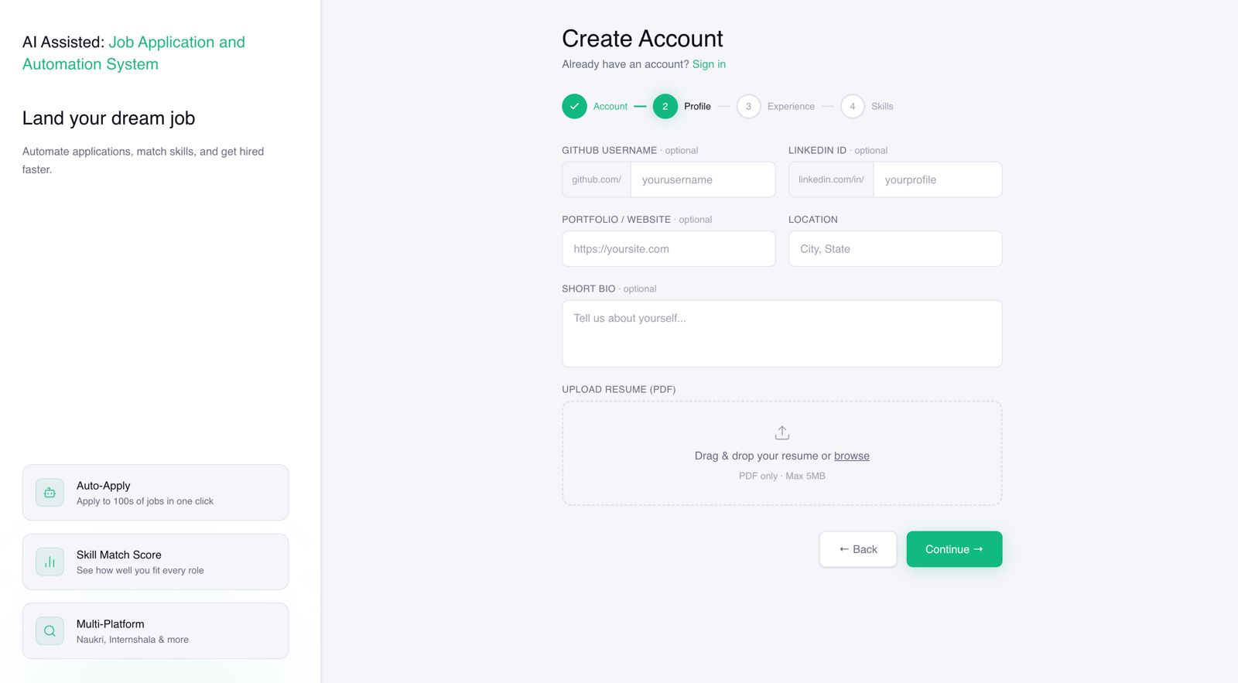
Madan Mohan Malaviya University of Technology, Gorakhpur
Results
Profile SetUp and Resume Parsing
Landing Page

Slide 12
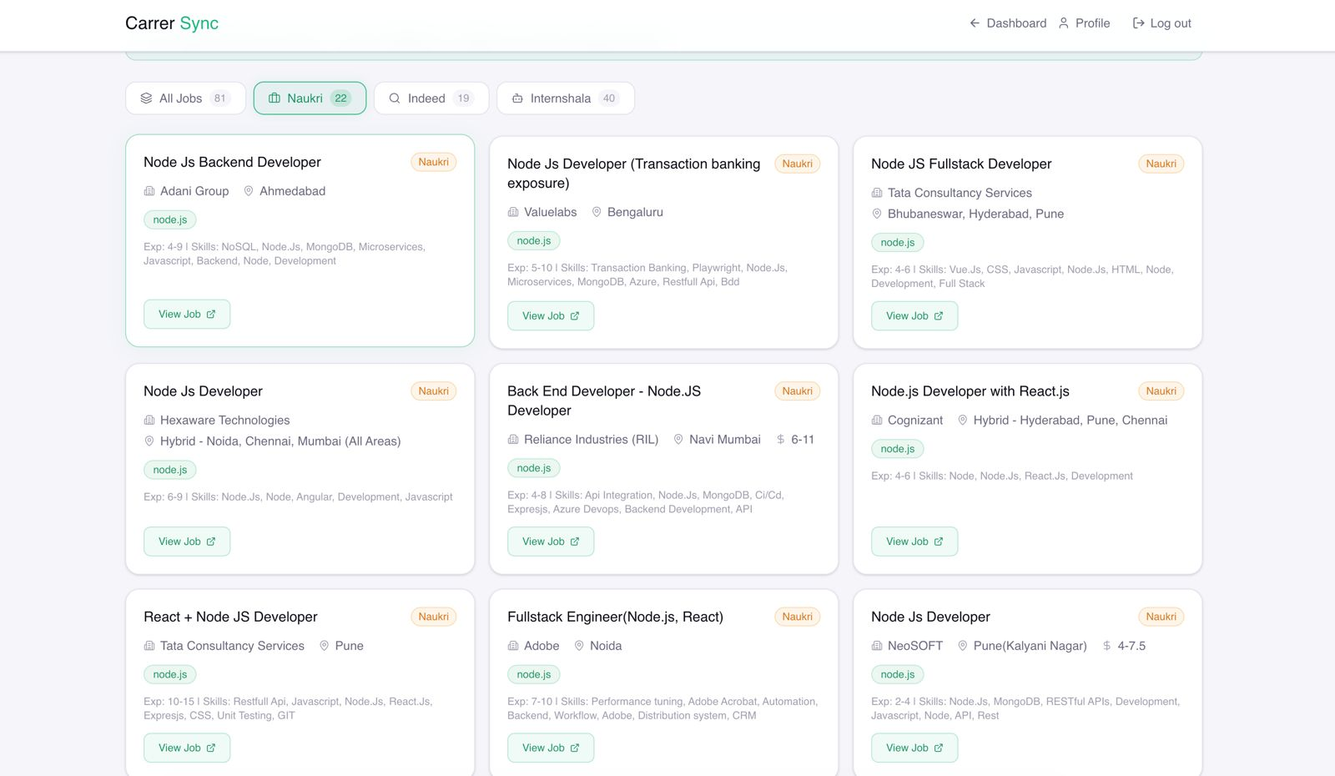
Madan Mohan Malaviya University of Technology, Gorakhpur
Results
Job Listing DashBoard

Slide 13

Madan Mohan Malaviya University of Technology, Gorakhpur
Challenges
1. Resume Parsing Accuracy
Mitigation: Use advanced NLP models, continuous training, and validation checks.
2. Job Data Inconsistency (Multiple Platforms)
Mitigation: Data normalization, filtering, and multi-source validation.
3. Auto-Apply Compatibility Issues
Mitigation: Platform-specific logic, fallback to manual apply.
4. User Data Privacy & Security
Mitigation: Secure storage, encryption, and authentication mechanisms.

Slide 14

Madan Mohan Malaviya University of Technology, Gorakhpur
Future Directions
Cover Letter Generation.
Skill Gap Analysis & Course Recommendation.
Advanced AI Job Matching.
Multi-Platform Job Support.
Multi-Resume Management.

Slide 15
Madan Mohan Malaviya University of Technology, Gorakhpur
References
[1] Chaimaa Lotfi, Swetha Srinivasan, Myriam Ertz, Imen Latrous, “Web Scraping Techniques and Applications” SCRS Conference Proceedings on Intelligent Systems (2021).
[2] S. B. Gulik, J. L. Choudhary, A. R. Gharat, and S. Kolhe, "Scraping of Job Portal," International Journal of Advance Research, Ideas and Innovations in Technology, vol. 7, no. 3, 2021.
[3] A. M. Kuthe, H. Donarkar, C. Patel, M. Qureshi, A. Bawankar, S. Chaurey, and R. Mahajan, "Optimising Job Search using Web Scraping," International Research Journal of Engineering and Technology (IRJET), vol. 11, no. 4, Apr. 2024.
[4] Rojan. Upreti, “Job Application Assistant Tool: An Integrated Chrome Extension and AI Powered Web Platform,” William Paterson University, USA, 2024.
[5] R. Muthu Kumar, “in Technology (IJIRT), vol. 12, no. 1, pp. 1215–1219, June 2025. AI-Based Resume Analyzer Using NLP and Machine Learning,” International Journal of Innovative Research.

Slide 16
Madan Mohan Malaviya University of Technology, Gorakhpur
Thank You!

